Slide 1

Risk Management Framework & Tools
Confidential
By ex-McKinsey, Deloitte and BCG Consultants specialized in Risk Management

Slide 2





This is a Risk Management Framework that we’ve been using and refining with our Fortune 500 clients and many SMEs
1.Risk Identification
2.Risk Assessment
3.Risk Prioritization
4.Risk Mitigation
5.Risk Closure
This framework can be used to manage the risk of a company or a project. It is simple and straightforward, which makes its implementation easy for everyone within your organization.

Slide 3




Let’s zoom on Risk Identification
1.Risk Identification
2.Risk Assessment
3.Risk Prioritization
4.Risk Mitigation
5.Risk Closure

Slide 4
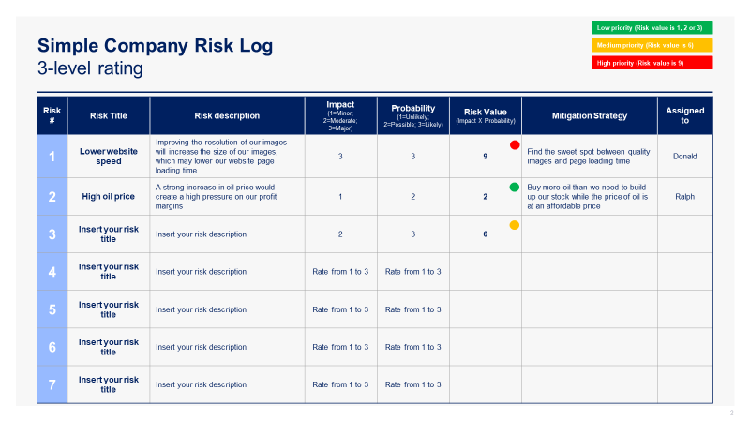
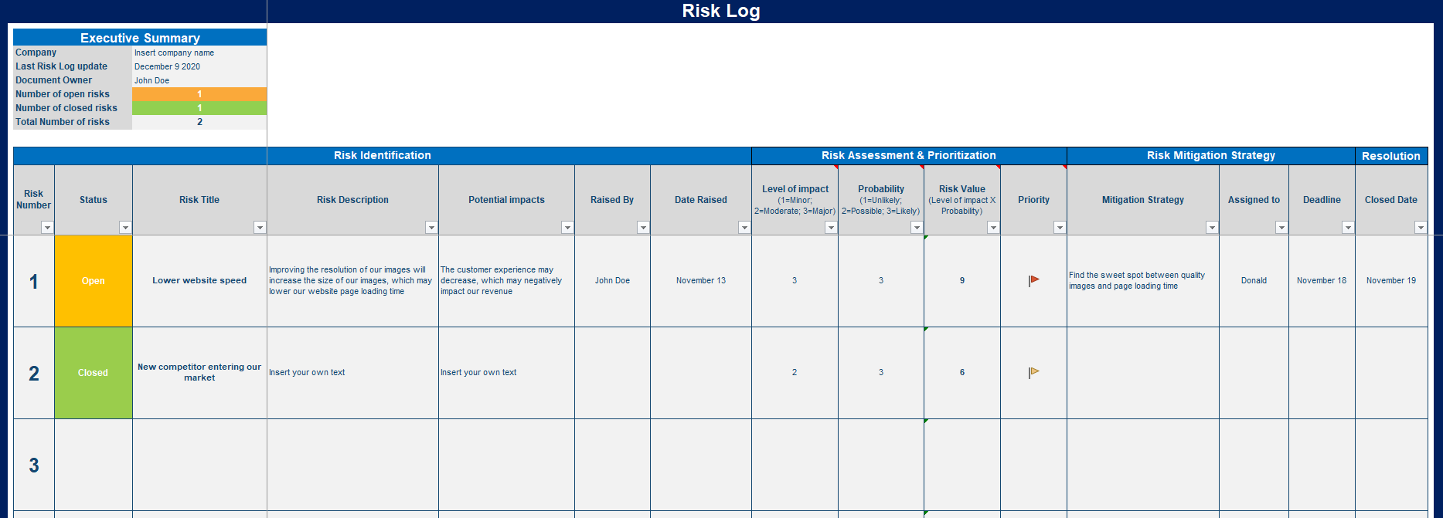
1.Risk Identification
The best way to identify the risks of your project or company is to use one of the 2 Risk Logs which are part of the Risk Management Toolkit:
Simple Risk Log in Powerpoint
Comprehensive Risk Log in Excel
The Simple Risk Log in Powerpoint is great if your list of risks is small or if you need to make a presentation in front of your Board of Directors, Executive Committee or any stakeholders that do not need to know too many details.
The Comprehensive Risk Log in Excel is great if you have a long list of risks and need to provide a lot of details for each one of them.
Our clients usually like to use both: They prefer to use the Comprehensive Risk Log in Excel during working sessions with their team. However, when they need to provide a high-level view to their manager or key stakeholders, they prefer to highlight the top 5 risks they identified using the Simple Risk Log in Powerpoint.
You’ll notice that we created risk logs for both a company and a project. These are 99% similar. Though, while using them, you may decide to customize them differently as your company may not have the same type of risks than your standard project. That’s why we believe your should have 2 different standard templates: one to manage the risks of your projects and to manage the risks of your company.

Slide 5

Let’s zoom on Risk Assessment
1.Risk Identification
2.Risk Assessment
3.Risk Prioritization
4.Risk Mitigation
5.Risk Closure

Slide 6
To assess your corporate risks or project risks correctly, it is important to use the following 2 dimensions
Probability
Impact
What is the probability of the risk to happen
What is the potential impact of the Risk
&

Slide 7
To assess the Probability of a risk to happen, you can use a 3-level rating or a 5-level rating depending on your needs
Probability 3-level rating
Probability Scale
Definition
3.Likely
Above 60% of chances to happen
2.Possible
Between 20% and 60% of chances to happen
1.Unlikely
Less than 20% of chances to happen

Slide 8
To assess the Probability of a risk to happen, you can use a 3-level rating or a 5-level rating depending on your needs
Probability 5-level rating
Probability Scale
Definition
5.Almost certain
Above 90% of chances to happen
4.Likely
Between 60% and 90% of chances to happen
3.Possible
Between 20% and 60% of chances to happen
2.Unlikely
Between 5% and 20% of chances to happen
1.Rare
Less than 5% of chances to happen

Slide 9
To assess the Potential Impact of a risk, you can use a 3-level rating or a 5-level rating depending on your needs
“Impact” 3-level rating
Impact Scale
Definition
3.Major
Risk will impact project success or company success
2.Moderate
Risk may impact project success or company success
1.Minor
Barely no impact on project success or company success

Slide 10
To assess the Potential Impact of a risk, you can use a 3-level rating or a 5-level rating depending on your needs
“Impact” 5-level rating
Impact Scale
Definition
5.Severe
Risk will cause Project failure or Company failure
4.Major
Risk will impact project success or company success
3.Moderate
Risk may impact project success or company success
2.Minor
Barely no impact on project success or company success
1.Marginal
No impact on project success or company success

Slide 11
By multiplying the dimension “Probability” by the dimension “Impact”, you get your “Risk Value”
Probability
Impact
Risk Value
What is the probability of the risk to happen
What is the potential impact of the risk
The risk value will help you prioritize your risks
X
=

Slide 12
Let’s zoom on Risk Prioritization
1.Risk Identification
2.Risk Assessment
3.Risk Prioritization
4.Risk Mitigation
5.Risk Closure

Slide 13
Your risk prioritization will depend on your risk value
Risk Value rating if you decided to use a 3-level rating to assess “impact” and “probability”
Risk Value
Score
Level of priority
High
9
Priority #1
Medium
6
Priority #2
Low
1, 2 or 3
Priority #3

Slide 14
Your risk prioritization will depend on your risk value
Risk Value rating if you decided to use a 5-level rating to assess “impact” and “probability”
Risk Value
Score
Level of priority
High
≥ 15
Priority #1
Medium
Between 6 & 14
Priority #2
Low
≤ 5
Priority #3

Slide 15
This 3 by 3 Risk Matrix will help you get a high-level view of all your risks. The risks in the red section should be your priority #1.
Insert risk name
Insert risk name
Insert risk name
Insert risk name
Insert risk name
3.Likely
Insert risk name
Insert risk name
Probability
2.Possible
Insert risk name
Insert risk name
Insert risk name
Insert risk name
1.Unlikely
1.Minor
2.Moderate
3.Major
Impact
Caption:
Priority 3 Risks
Priority 2 Risks
Priority 1 Risks

Slide 16
Some of our clients also like to use this 5 by 5 Risk Matrix to get a high-level view of all their risks. The risks in the dark red section are priority #1 risks
5.Almost
certain
Insert risk name
Insert risk name
Insert risk name
Insert risk name
Insert risk name
4.Likely
Probability
Insert risk name
Insert risk name
Insert risk name
Insert risk name
3.Possible
2.Unlikely
Insert risk name
1.Rare
1.Marginal
2.Minor
3.Moderate
4.Major
5.Severe
Impact
Caption:
Priority 5 Risks
Priority 4 Risks
Priority 3 Risks
Priority 2 Risks
Priority 1 Risks

Slide 17
With the 5 by 5 Risk Matrix, you can use this risk value 5-level rating
Risk Value 5-level rating
Risk Value
Definition
Very high
Risks which should be considered as your Priority #1
High
Risks which should be considered as your Priority #2
Medium
Risks which should be considered as your Priority #3
Low
Risks which should be considered as your Priority #4
Very low
Risks which should be considered as your Priority #5

Slide 18
Let’s now zoom on Risk Mitigation
1.Risk Identification
2.Risk Assessment
3.Risk Prioritization
4.Risk Mitigation
5.Risk Closure

Slide 19
Define for each risk your risk mitigation strategy
The objectives of your risk mitigation strategy should be to:
Decrease the probability of the risk to happen or, if possible, totally remove the likelihood of the risk to happen
Decrease the level of impact of the risk
Your risk mitigation strategy should include:
Clear actions on what needs to be done
A deadline on when the actions needs to be implemented
A person responsible for mitigating the risk
Both our Simple Risk Log in Powerpoint and our Comprehensive Risk Log in Excel (which are part of our Risk Management Toolkit) include a risk mitigation strategy section that you can easily fill in.

Slide 20
Let’s now zoom on Risk Closure
1.Risk Identification
2.Risk Assessment
3.Risk Prioritization
4.Risk Mitigation
5.Risk Closure

Slide 21
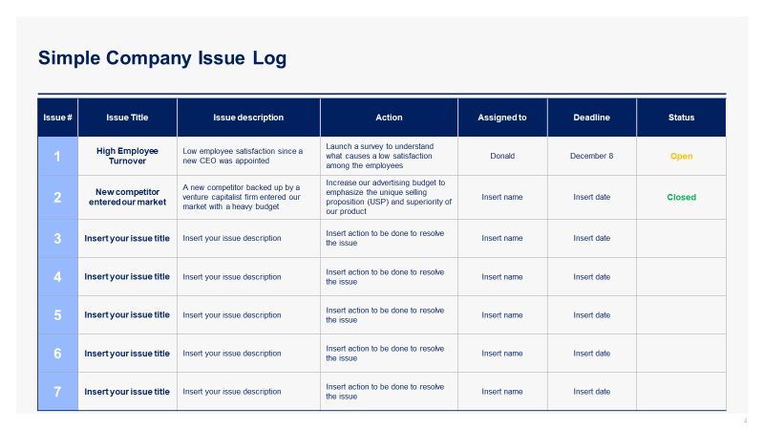
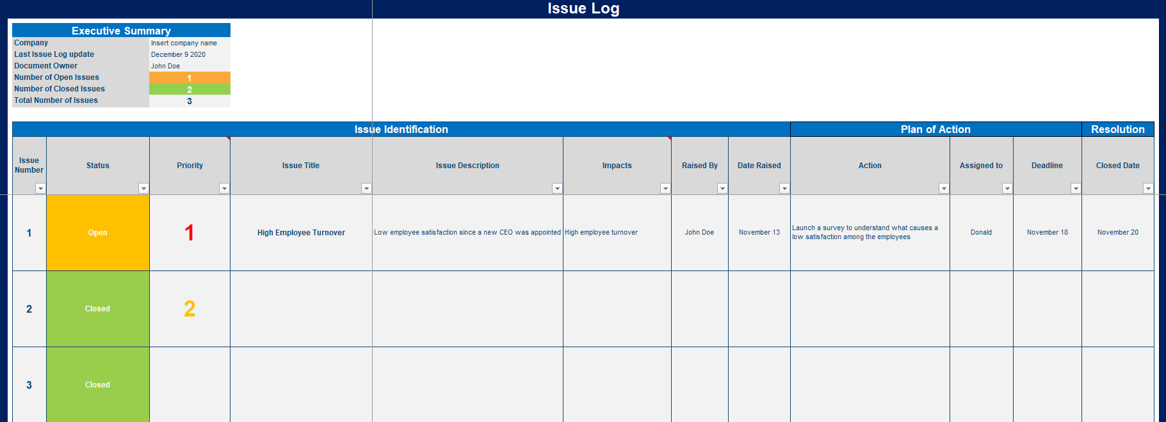
There are mainly 2 reasons to close a Risk
The implementation of your risk mitigation strategy worked, and the risk value is now very low or equal to zero
Despite your risk mitigation strategy, the risk became a reality. In this situation, you need to close the risk and create an “issue” using one of these 2 Issue Logs, which are part of the Risk Management Toolkit:
Simple Issue Log in Powerpoint
Comprehensive Issue Log in Excel
The Issue Log will help you define the issue and a plan of actions to resolve it

Slide 22









Interested in more Business & Consulting Toolkits? Our ex-McKinsey, Deloitte & BCG Consultants created 10 Toolkits including practical Frameworks, Tools & Templates
1.Corporate & Business Strategy Toolkit
2.Management Consulting Toolkit
3.Change Management Toolkit
4.Project Management Toolkit
5.Sales, Marketing & Communication Toolkit
Visit Website
Visit Website
Visit Website
Visit Website
Visit Website
6.Finance and Mergers & Acquisitions Toolkit
7.Digital Transformation Toolkit
8.Operations & Supply Chain Toolkit
9.Leadership Skills Toolkit
10.Legal Toolkit
Visit Website
Visit Website
Visit Website
Visit Website
Visit Website

Slide 23
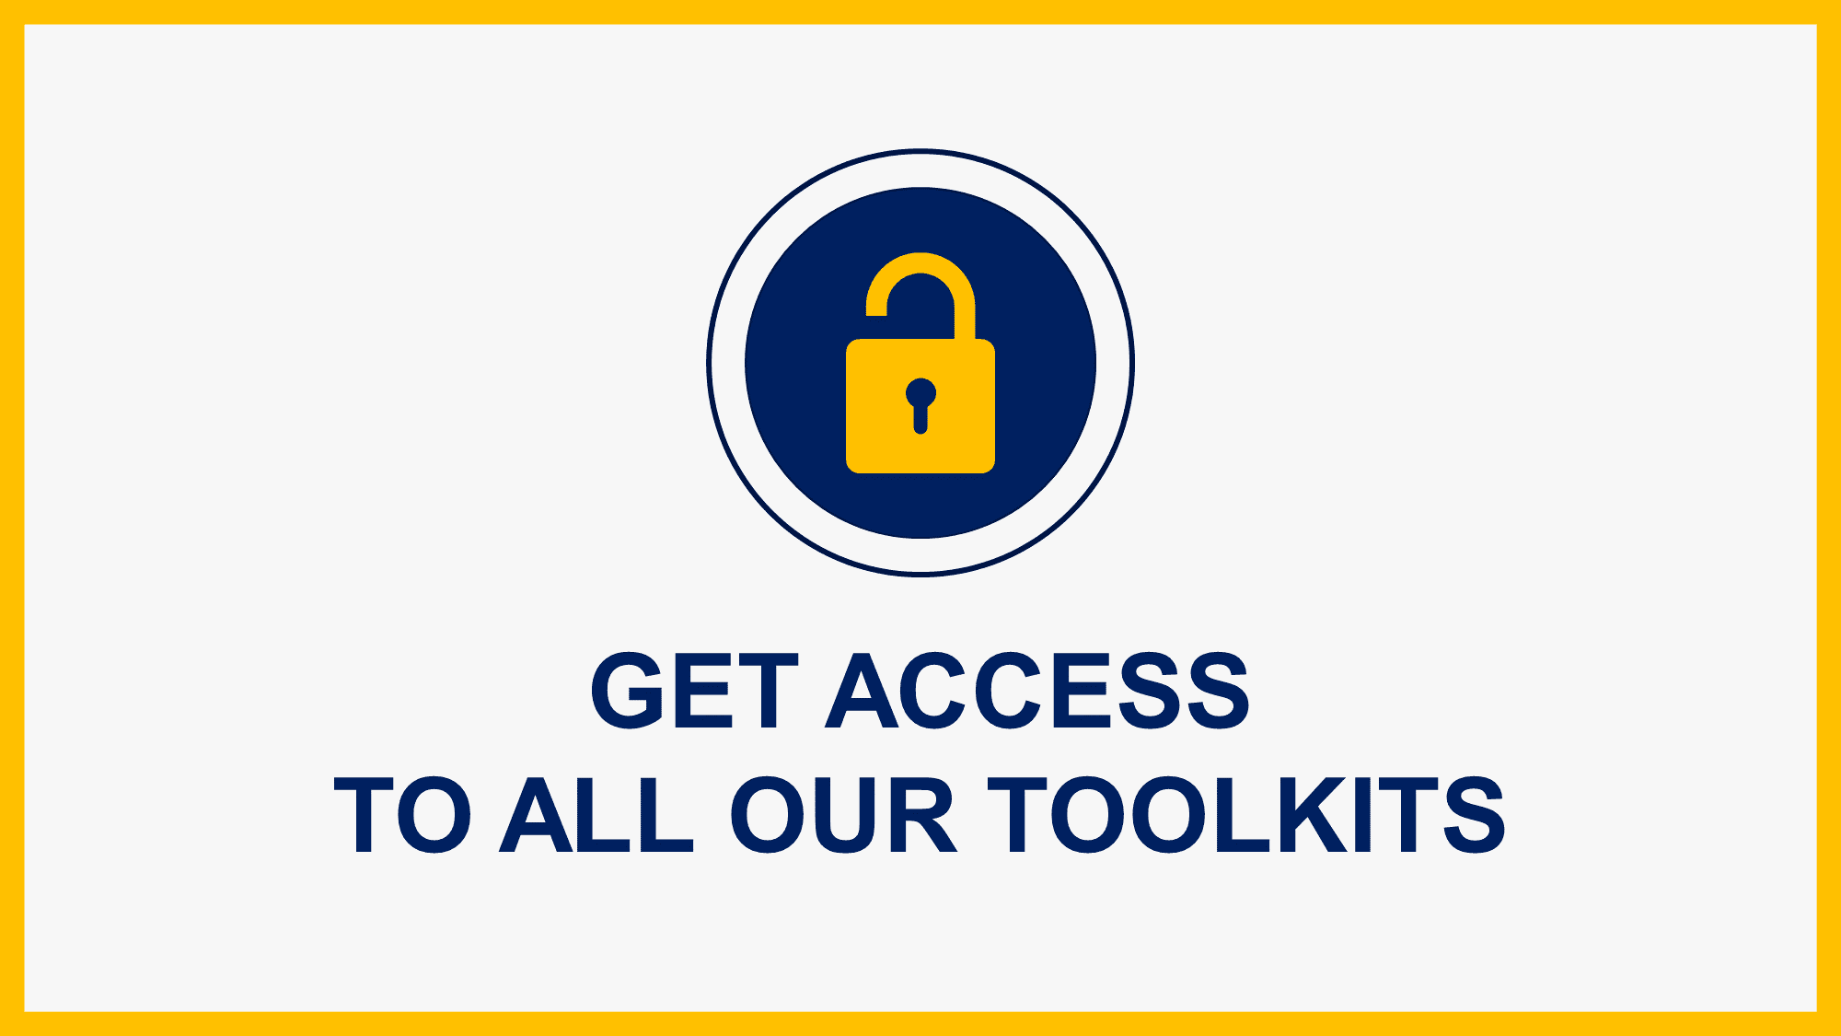
Interested in multiple Business & Consulting Toolkits? Get access to all our Toolkits for half the price with the Gold Business & Consulting Package
Gold Business & Consulting Package
Learn More
www.slidebooks.com

Slide 24
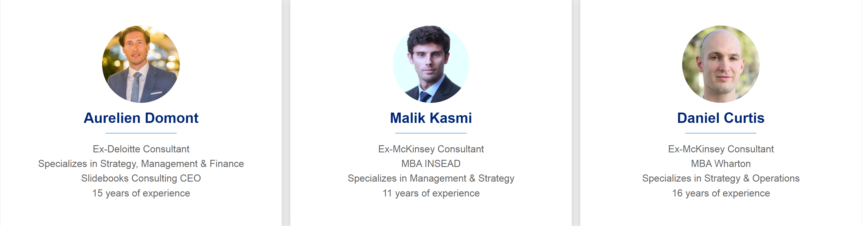


Need more help? Hire one of our Management Consultants for $4,000 a day
See more Management Consultants

Slide 25
Thanks for your attention!
www.slidebooks.com

